Slide 1
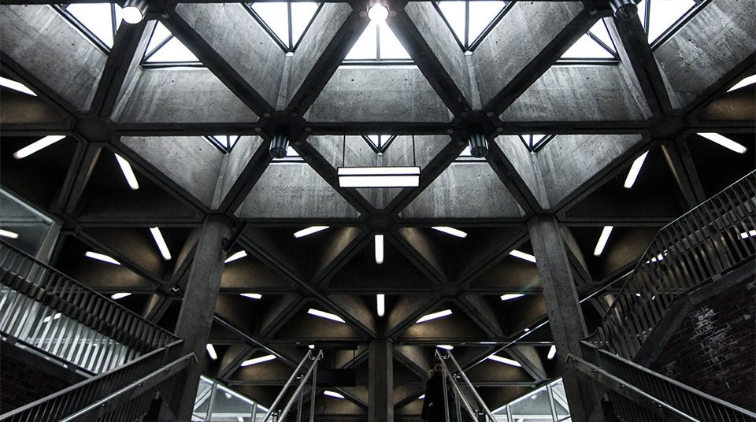
SIT314 – Software Architecture and Scalability for internet of THINGS
2
+
2
+
7.1P-FINAL PROJECT PRESENTATION

Slide 2
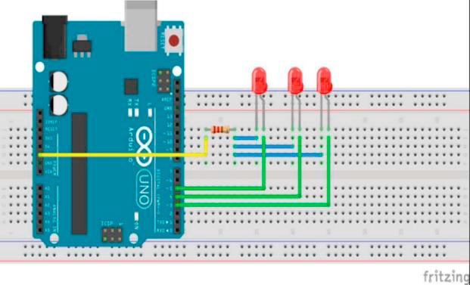
INTRODUCTION
2
+
IoT is a network of networked devices with increased ability to communicate with each other, humans, and their physical surroundings to execute various activities. The goal of this project is to create a Smart Lighting System that can be maintained for large buildings with thousands of buildings and switches. The study focuses on creating a system that uses the smart lighting system for large buildings without impacting any other aspects of the structure and maintaining the capacity to alter the intensity of lights while also providing fault notifications.

Slide 3
Requirements of system
2
+
The smart lighting system must be scalable for large buildings that use hundreds and thousands of lights and switches, which implies that the system's reliability and performance should not be compromised as that of the number of lights and switches increases.
It should regulate the intensity of the light or switch it off and on based on the lighting conditions of the area.
It must be able to generate an alarm if some of the LEDs fail or exhibit strange behavior. For example, the system can use MQTT and Complex Event Processing to detect faulty LEDs and generate alerts so that they can be repaired or replaced.
Also, it should be able to provide users with information about the intensity of the room and the state of the LED in relation to it. For example, if the light intensity of the room is high, the system should keep the LEDs off, and if it falls below the threshold, the system should be able to automatically switch the LEDs on.

Slide 4
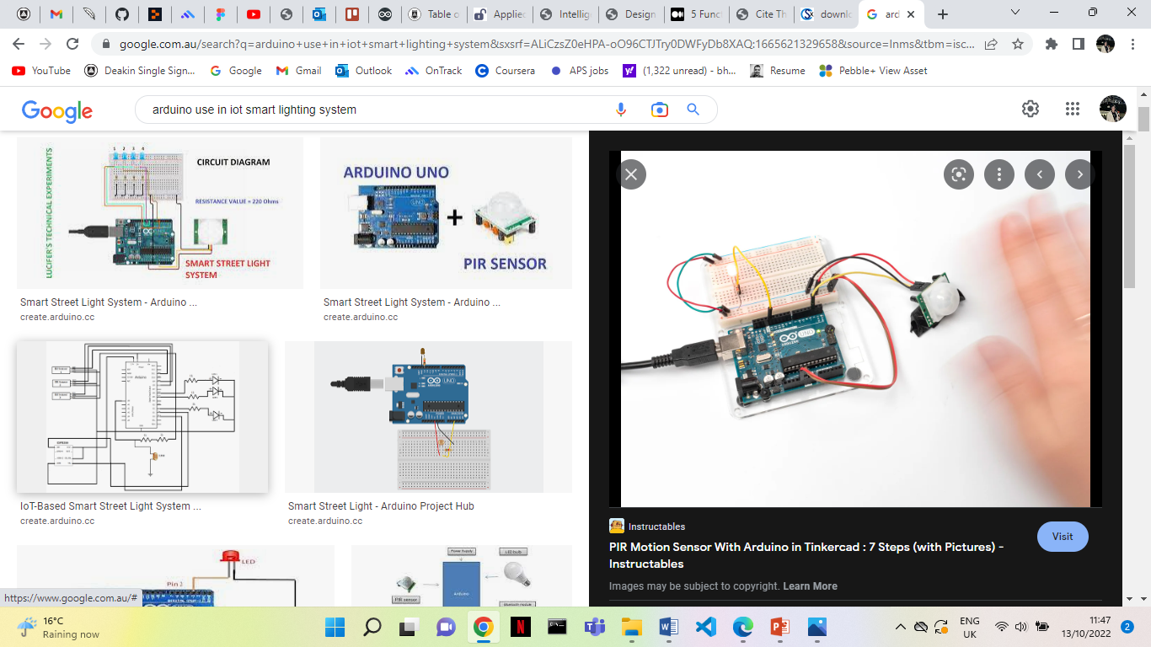
Requirements of system
2
+
Moreover, it should give the user a visual representation of the data obtained so that the user can analyze how the lights operate and how much energy is being consumed which can also be minimized or maximized.
Additionally, the system should not suffer from any sort of lags as a consequence of the increased lighting in the building and should be able to offer the same output. Hence, the system can leverage EC2 instances and a load balancer to balance the load and reduce server press.
Furthermore, the data for all of the rooms and areas in the buildings, their LEDs and switches must be safely maintained in online databases that can only be accessed by authorized corporate personnel and should provide adequate secure methods to avoid data hacking.

Slide 5
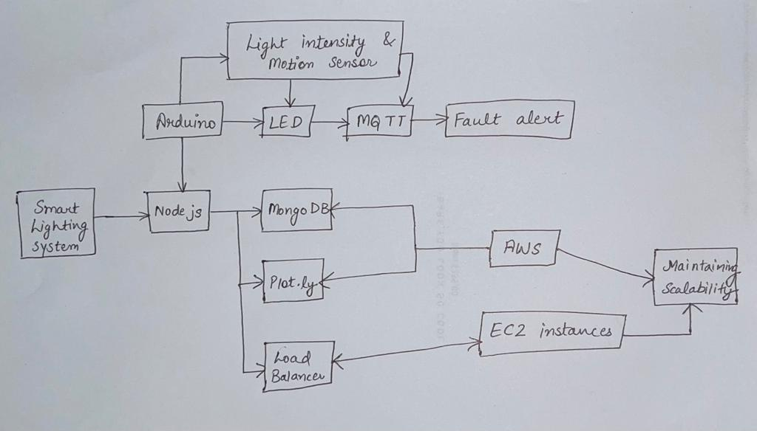
SYSTEM DESIGN
This prototype is designed with Arduino (C++) and the Node.js framework. Arduino is connected to LEDs and a Light sensor. A light sensor is a photo resistor that reads light intensity. When it is connected it is run on the Arduino IDE, using the C++ language delivering data on a serial port which will be about the light intensity of the rooms and areas in the building. Using the serial port library, the server will accept data provided by Arduino and sensors. This setup stores data in MongoDB and visualizes it with plot.ly. Firebase, Pub Nub, Socket.io and Pusher can also be used to create a live graph that updates in real - time basis.
The light intensity sensor will be used to determine the intensity of the room in order to adjust the intensity of the LED correspondingly.

Slide 6
The link for the working model is: https://deakin365-my.sharepoint.com/:f:/g/personal/mkbhullar_deakin_edu_au/EpwgnWiYZolMppbIofRS3L8BTrQfkRnwwQVxGCNZw56X_Q?e=U2adZT
2
+
2
+

Slide 7
THANK YOU
2
+
2
+

